Slide 1
Model Interpretability
SHAP - SHapley Additive exPlanations

Slide 2
Should we trust models?
A model predicts a certain outcome with a rationale.
Interpretability ensures the acceptance of an ML algorithm.
WHY
Insights into the prediction
Transparency: right to explanation
Reduced bias

Slide 3
Accuracy vs. Interpretability
Simple models | Complex models
Less accurate | More accurate
Simple patterns | Complex patterns
Straightforward interpretation | No straightforward interpretation
E.g. linear/logistic regression, Naïve Bayes | E.g. random forest, gradient boosting, neural network

Slide 4
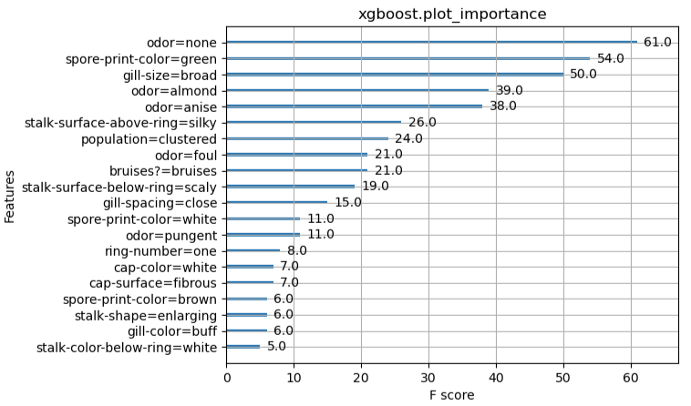
Feature importance
Mushroom classification
Edible (0) vs Poisonous (1)

Slide 5
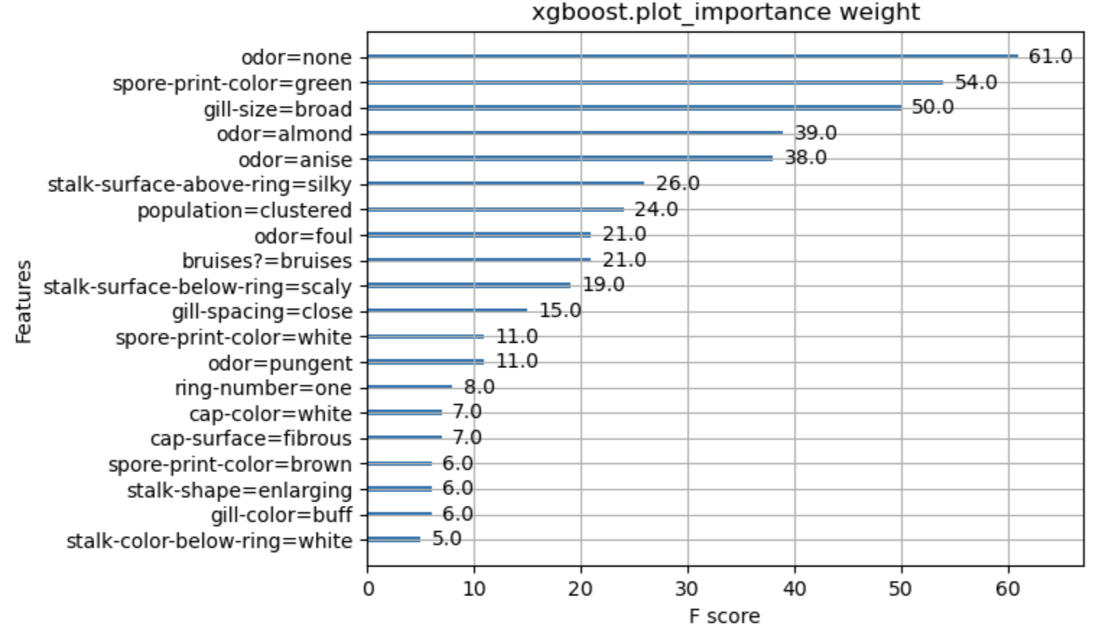
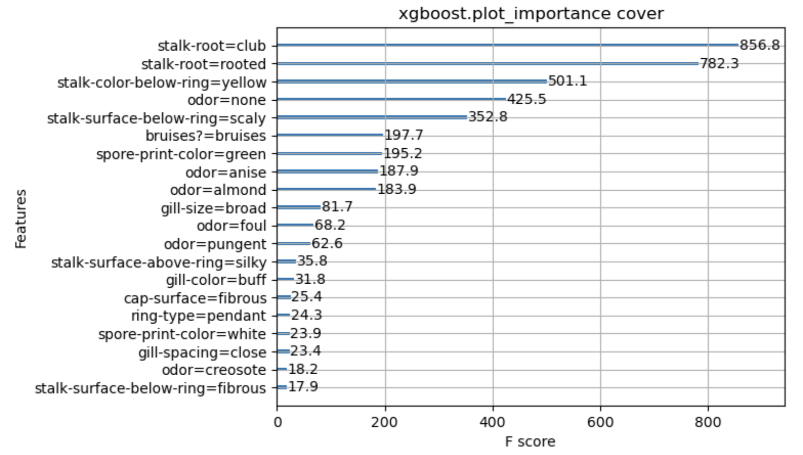
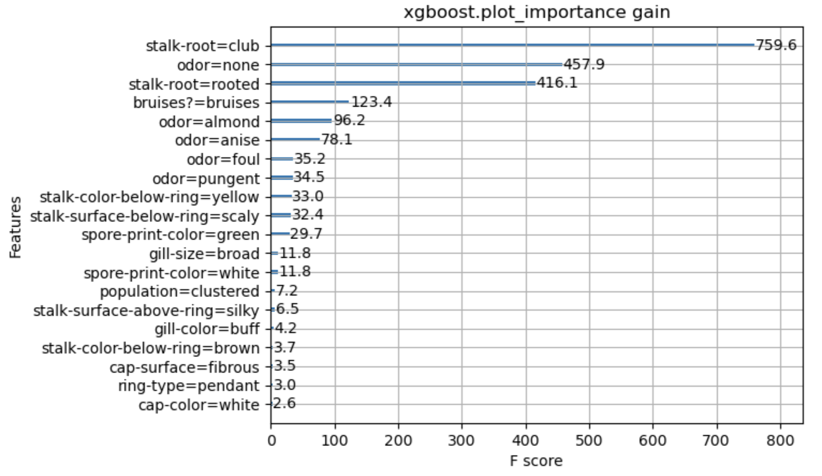
Importance measures
Weight: how many times a feature is used to split the data
Cover: how many times a feature is used to split the data, weighted by splitting size
Gain: how much loss reduction is gained when a feature is used to split the data

Slide 6
Properties of a feature attribution method
Consistency
model is changed to rely more on a feature
~ feature importance does not decrease
Accuracy
sum of feature contributions = final prediction
Missingness
feature contribution = 0 ~ feature removal has no impact

Slide 7
SHAP: SHapley Additive exPlanations
Cooperative game theory concept: Shapley values
Model-agnostic
Consistent and accurate feature importance
Local explanation of individual prediction

Slide 8
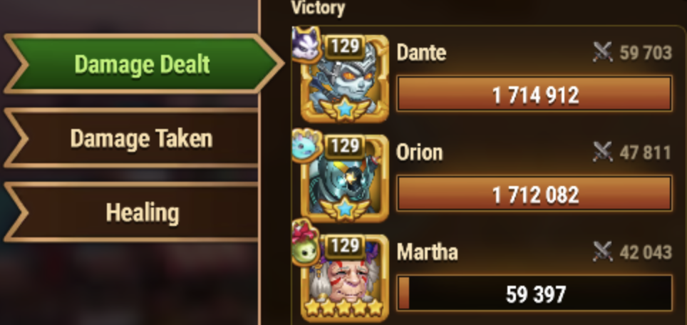


Shapley values
Lloyd Shapley, 1953
Cooperative game => Payouts to players upon their contribution to the total payout

Slide 9
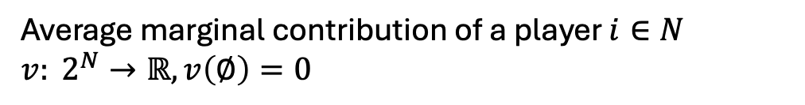
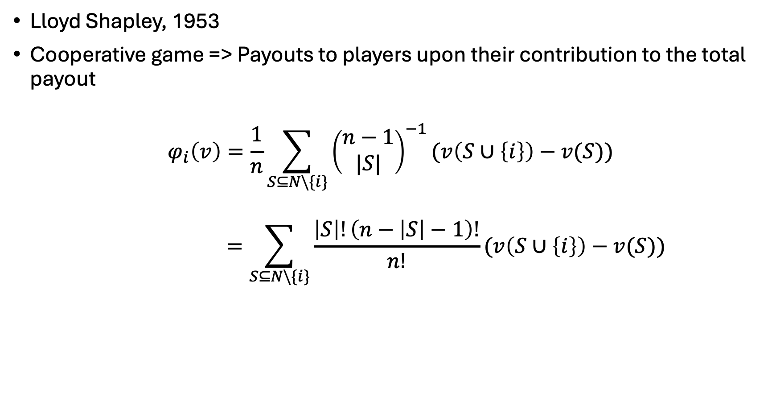
Shapley values
Lloyd Shapley, 1953
Cooperative game => Payouts to players upon their contribution to the total payout
$$φ_{i}\left(v\right)=\frac{1}{n}\sum_{S⊆N\backslash \{i\}}{{\left(\begin{aligned}n−1 \\ |S|\end{aligned}\right)}^{−1}}(v\left(S∪\left\{i\right\}\right)−v(S))$$
$$=\sum_{S⊆N\backslash \{i\}}{\frac{\left|S\right|!\left(n−\left|S\right|−1\right)!}{n!}}(v\left(S∪\left\{i\right\}\right)−v(S))$$
Average marginal contribution of a player $i∈N$
$v: 2^{N}→ℝ, v\left(∅\right)=0$
https://christophm.github.io/interpretable-ml-book/shapley.html

Slide 10
Intuition
Players play the game in an arena
Player i enters the arena to join some existing random players
Change the game outcome
Shapley value of i = average change on all scenarios of random players in the arena

Slide 11
Shapley values
Lloyd Shapley, 1953
Cooperative game => Payouts to players upon their contribution to the total payout
ML => Contribution of a feature value to difference between the actual prediction and the mean prediction
game = prediction task for an instance of the dataset
players = feature values of the instance
gain = actual prediction – mean prediction
https://christophm.github.io/interpretable-ml-book/shapley.html

Slide 12
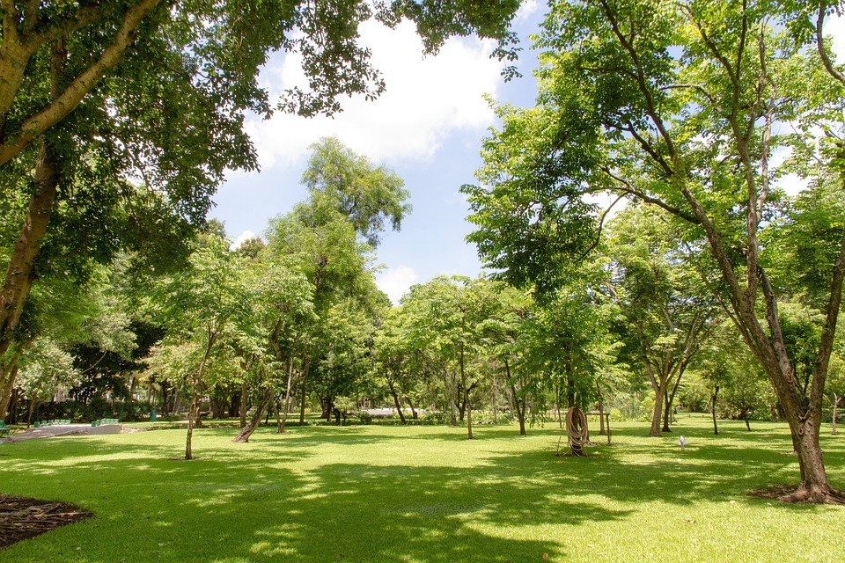


Example: Price prediction
Average price 510000 CHF
-10000 CHF
Park-nearby 20000 CHF
Surface-60 10000 CHF
Floor-3 0 CHF
Animal-banned -40000 CHF
500000 CHF
https://christophm.github.io/interpretable-ml-book/shapley.html

Slide 13
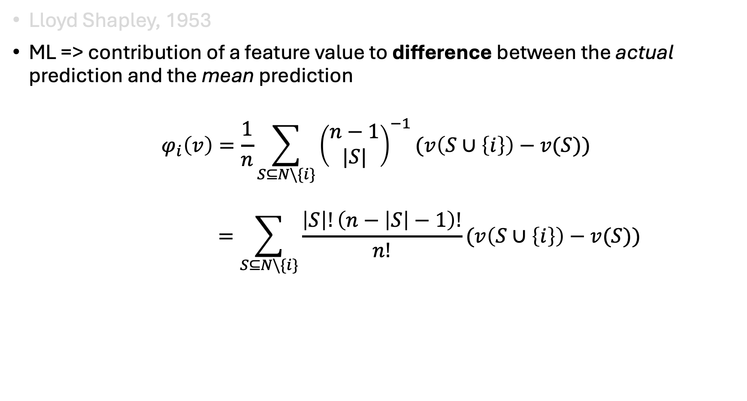
Shapley values
Lloyd Shapley, 1953
ML => contribution of a feature value to difference between the actual prediction and the mean prediction
$$φ_{i}\left(v\right)=\frac{1}{n}\sum_{S⊆N\backslash \{i\}}{{\left(\begin{aligned}n−1 \\ |S|\end{aligned}\right)}^{−1}}(v\left(S∪\left\{i\right\}\right)−v(S))$$
$$=\sum_{S⊆N\backslash \{i\}}{\frac{\left|S\right|!\left(n−\left|S\right|−1\right)!}{n!}}(v\left(S∪\left\{i\right\}\right)−v(S))$$
Average marginal contribution of a feature value across all possible coalitions
https://christophm.github.io/interpretable-ml-book/shapley.html

Slide 14
Feature importance
Mushroom classification
Edible (0) vs Poisonous (1)
xgb_model = xgboost.XGBClassifier(**params).fit(X_train, Y_train)
xgboost.plot_importance(xgb_model)

Slide 15
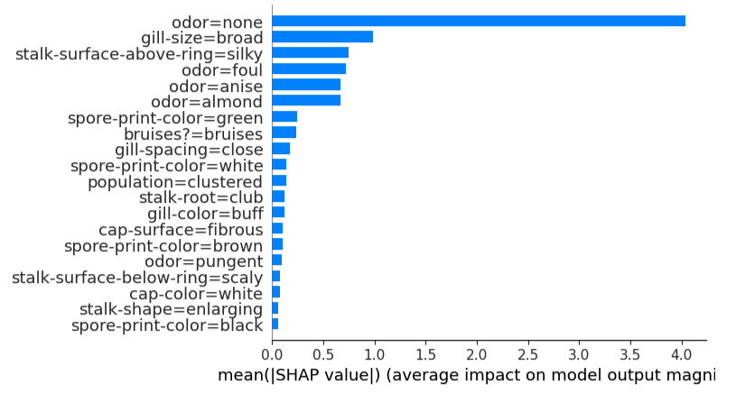
SHAP Feature importance
Mushroom classification
Edible (0) vs Poisonous (1)
explainer = shap.TreeExplainer(xgb_model)
shap_values = explainer.shap_values(X_train)
shap.summary_plot(shap_values, X_train, plot_type='bar')

Slide 16
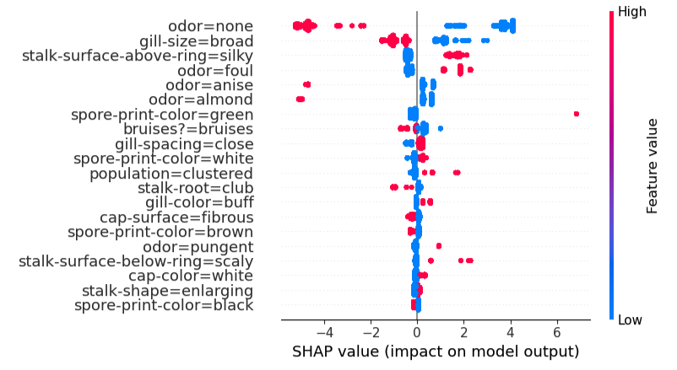
SHAP Summary plot
Summarize feature contribution for all instances
explainer = shap.TreeExplainer(xgb_model)
shap_values = explainer.shap_values(X_train)
shap.summary_plot(shap_values, X_train)

Slide 17
SHAP Local explanation – Force plot
Y[0] = 0: Edible
Y[1] = 1: Poisonous
explainer = shap.TreeExplainer(xgb_model)
shap_values = explainer.shap_values(X_test)
shap.force_plot(explainer.expected_value, shap_values[i,:], X_test.iloc[i,:])

Slide 18
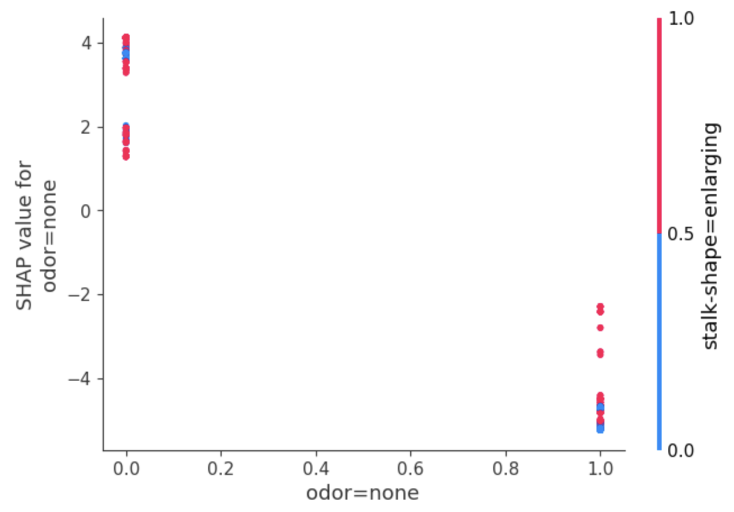
SHAP Dependence plot
Visualize relationship between a feature and the model’s prediction
explainer = shap.TreeExplainer(xgb_model)
shap_values = explainer.shap_values(X_train)
shap.dependence_plot('odor=none', shap_values, X_train, interaction_index='stalk-shape=enlarging')

